Slide 1
Weekly meeting 8/29
Yu-Xuan Chen

Slide 2
Block Diagram
Modeling delay
HRTF
M(k)
u(k)
+
e(k)
Virtual source signals (N_{i})
Acoustic system
Filters
Ear signals
at control
points (N_{c})
G(k)
H(k)
Speaker inputs (N_{s})

Slide 3

6mic 24source

Slide 4
8mic 24source

Slide 5
8mic 72source

Slide 6
8mic 72source

Slide 7
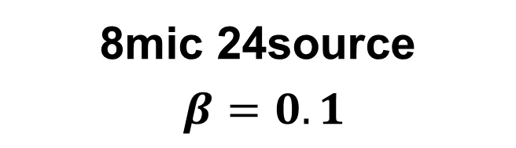
8mic 24source $β=0.1$

Slide 8
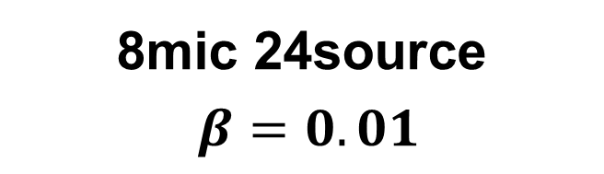
8mic 24source $β=0.01$

Slide 9
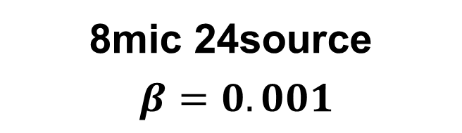
8mic 24source $β=0.001$

Slide 10


